Slide 1
2019 POPCORN KICKOFF
Prairielands Council
Join Scout leaders across the country to share best practices and new ideas!
Facebook.com/groups/TEPopcornCommunity
Text “Commit” to 62771

Slide 2
WHY DO WE DO THIS?
Notes:
4 min
https://www.youtube.com/watch?v=RsYY3uMkFwU&t=2s

Slide 3
THANK YOU
YOU’VE RAISED OVER $4 BILLION FOR SCOUTING SINCE 1980!
Thank you for your allowing us to partner with you and your Scouts to raise the funds needed to deliver the promise of Scouting for over 39 years.
Great job!
Notes:
1 min

Slide 4
IT’S FOR THE SCOUTS
2018 POPCORN UNIT COMMISSIONS $137,656
By selling popcorn Scouts improve their communication skills and learn goal achievement.
With the income generated from popcorn sales in 2018, we provided 30 camperships to Scouts in need, bought a new sailboat for Camp Drake, and renovated the showers at the pool for our summer camp operation.
Notes:
2 min

Slide 5
THE POPCORN SALE
BEST PRACTICES
Notes:
2 min

Slide 6
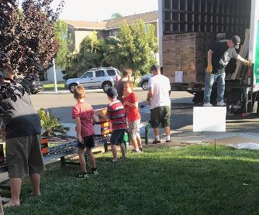
PLANNING
BUILD A TEAM
Shared ideas, shared efforts.
Prevent burnout.
Pass down tribal knowledge.
PLAN LIKE A BUSINESS
Why does your Unit sell Popcorn?
Plan your Ideal Year of Scouting.
Calculate your IYOS Cost.
Create your Scout sales goal.
Agenda

Slide 7
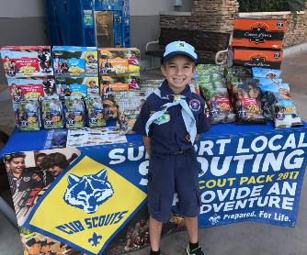
STOREFRONT SALES
SELL AT STOREFRONTS
One Scout per 2-Hour Shift
Maximize Hourly Sales
Use every store in your area
$18 Avg. Transaction, $100+/hr
Recruit at the Storefront!
RECRUITING
We’re already selling Scouting!
Scouts recruiting Scouts
Have flyers
Interest list
Agenda

Slide 8
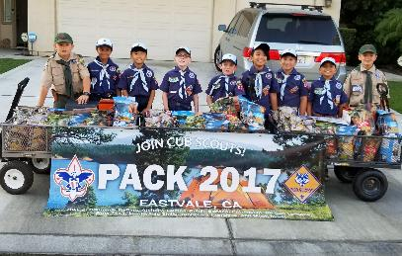
PERSONAL SALES
DOOR TO DOOR
Neighbors
$28 Avg. Transaction, $100/hr
FRIENDS,FAMILY, WORKPLACE
Door to Door
Friends & Family, Workplace
BLITZ DAYS
Dens & Patrols are assigned neighborhoods
Top Selling Den incentive
Social gathering after
Agenda

Slide 9
ONLINE SALES
FREE SHIPPING ON ALL ONLINE ORDERS!
In 2018, the average online transaction was $73.
The average Scout that sold online averaged over $200 in online sales!
CREATE ACCOUNTS
Scouts need an account to sell online.
Consider an account creation incentive.
SHARING
Sharing drives sales.
Facebook
Email
Text
Twitter, LinkedIN, etc
“Sharing Sunday” – Every Scout shares their online page every Sunday throughout the sale. Average share is $33 nationwide.

Slide 10
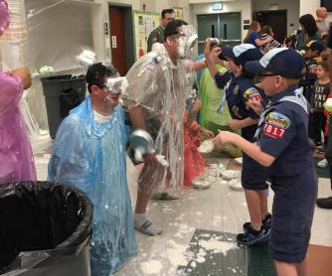
MOTIVATING SCOUTS
SCOUT MOTIVATION
Every Scout Sells
Set a Goal
Bigger Prizes
PARENT BUY-IN
Scouts Personal Growth
Scout Rewards
KICKOFF
Info
FUN!
Parent Buy-In
Top Seller Pledge
Agenda

Slide 11
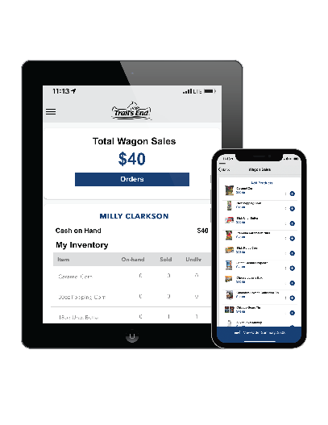
TRAIL’S END APP
SAVE TIME MANAGING YOUR SALE!
The app for Scouts to track and report real-time storefront, wagon and online sales, accept cash and credit cards, track inventory by Scout and storefront, and schedule Scouts for storefronts.
FREE CREDIT CARD PROCESSING
Powered by Square | Paid by Trail’s End
Every Scout, every sale will receive free payment processing.
Square is the leading credit card solution for units.
Compatible with all Square Readers (not required to take credit cards).
PROVEN RESULTS
Over 2,300 Scouts tested the app. It led to more sales!
In 2018, over 190 units sold almost $2 million testing the app.
Sales grew 26%.
Credit card orders averaged 20% higher vs. cash.
Notes:
3 min

Slide 12
TRAIL’S END APP – HOW IT WORKS
https://www.youtube.com/watch?v=Z2Ypp6AMlZ0
Learn more at App.Trails-End.com
Notes:
1 min

Slide 13
TRAIL’S END APP – STOREFRONT SALES
https://www.youtube.com/watch?v=f3OxkORlb9I
Learn more at App.Trails-End.com
Notes:
2 min

Slide 14
TRAIL’S END APP – WAGON SALES
https://www.youtube.com/watch?v=GJYopyUO8Jo
Learn more at App.Trails-End.com
Notes:
2 min

Slide 15
TRAIL’S END APP – UNIT CREDIT PAYMENTS
https://www.youtube.com/watch?v=K74OgK6aeAM
Learn more at App.Trails-End.com
Notes:
2 min

Slide 16
TRAIL’S END APP – HOW TO SELL WITH THE APP
https://www.youtube.com/watch?v=SqyzkaqBmfM
Learn more at App.Trails-End.com
Notes:
2 min

Slide 17
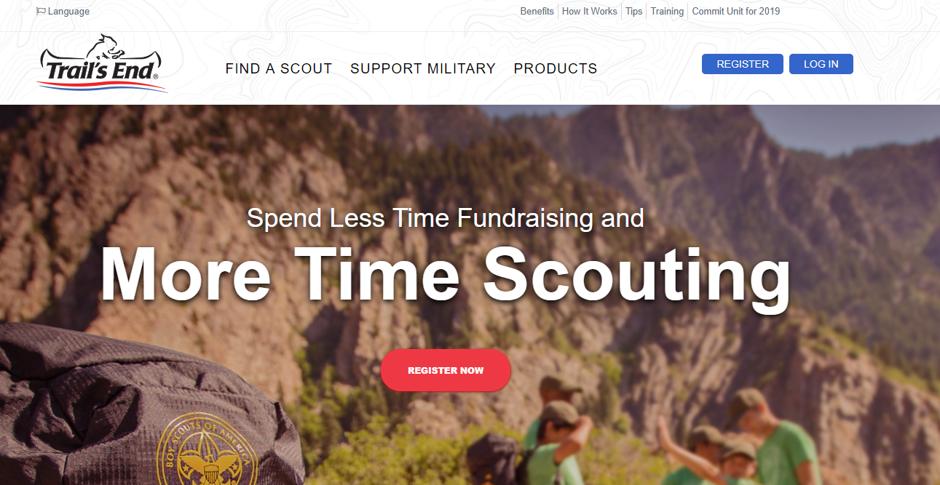
TRAILS-END.COM UNIT PORTAL
Recap: Manage your entire sale in one place!
Order Popcorn
Invite your Scouts to register
Set your unit and Scout goals
Manage your Scout Roster
Set your Storefront Sales Calculation Method
Give access to additional Popcorn Team members
Add your unit’s bank account to receive payments
Manage your unit’s:
Inventory
Wagon Sales
Storefront Sales
Online Sales
Notes:
3 min

Slide 18
TRAIL’S END APP
Q&A (10 minutes)
Go to App.Trails-End.com/unit-training to register for training webinars!
Notes:
2 min

Slide 19
TRAIL’S END REWARDS
SCOUTS BUY THE PRIZES THEY WANT WITH AN AMAZON.COM GIFT CARD
Amazon.com Gift Cards are claimed on the Rewards page within the Scout’s account in the app and Trails-End.com when certain sales levels are reached and approved by a unit leader.
BENEFITS FOR LEADERS
Save time by not collecting prize orders from your Scouts
Save effort by no longer distributing physical prizes
Happier Scouts because they get the prizes THEY want
BENEFITS FOR SCOUTS
Higher prize value than other fundraisers
Millions of prizes to choose on Amazon.com
Prizes delivered directly to your door faster than ever before
Notes:
3 min

Slide 20
TRAIL’S END REWARDS
https://www.youtube.com/watch?v=Fq3pby76NCU
Notes:
1 min

Slide 21
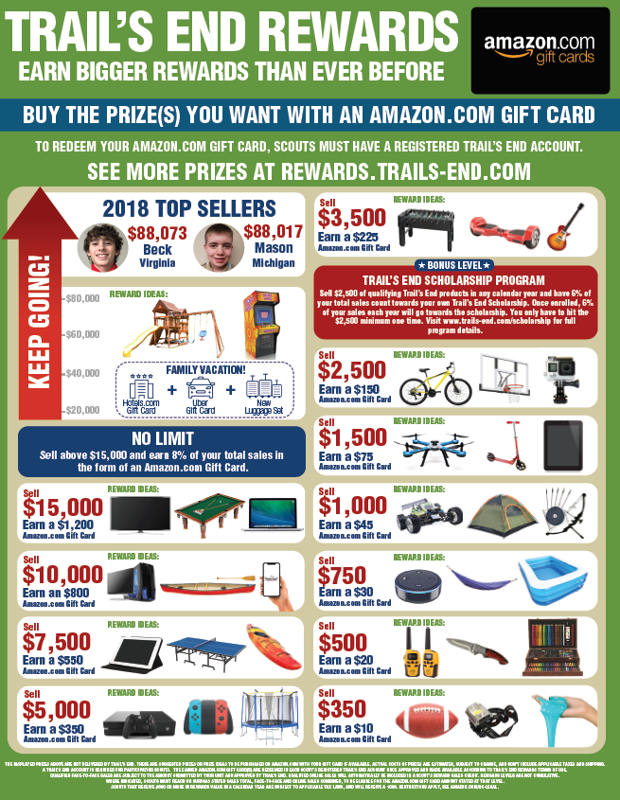
Prize Flyer
Rewards.Trails-End.com
Notes:
3 min

Slide 22
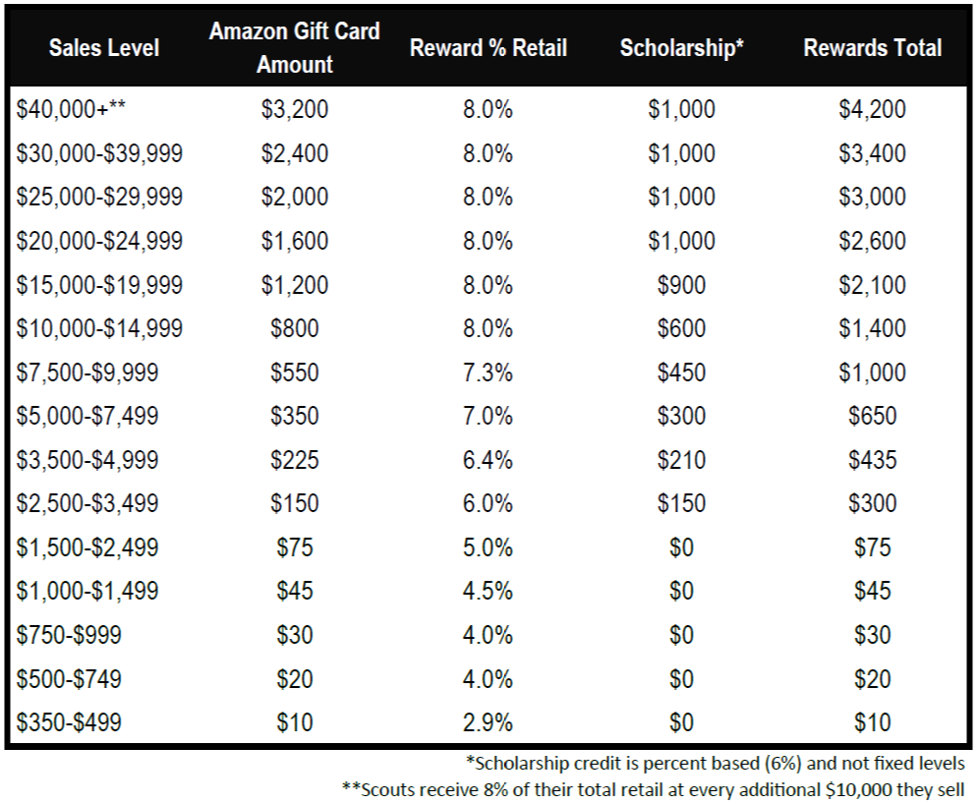
TRAIL’S END REWARDS
Notes:
1 min

Slide 23
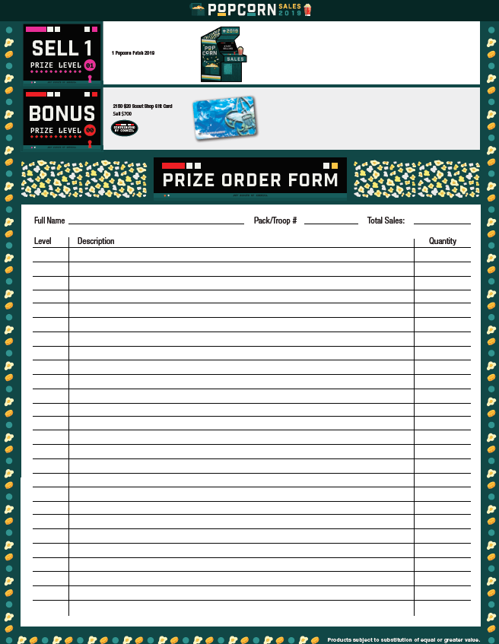
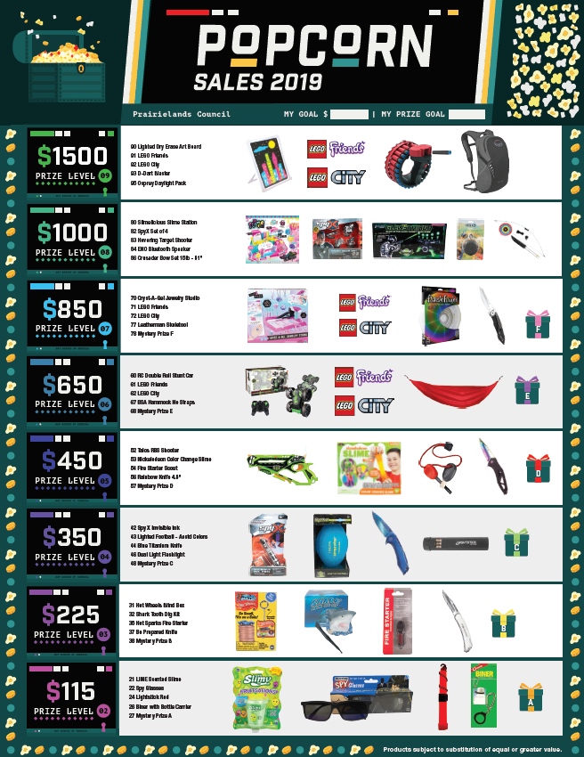
National Prize Flyer
Prize levels to only $1,500
Notes:
3 min

Slide 24
TRAIL’S END SCHOLARSHIP
Sell $2,500
(combined face-to-face & online)
6% of your total sales each calendar year invested in your own college scholarship account.
Funded By Trail’s End
Notes:
1-2 min

Slide 25
PRAIRIELANDS COUNCIL INCENTIVES
2nd Place in Council
Ipad 6th Generation
32 GB Wifi
3rd Place in Council
GoPRO HERO Waterproof
Digital Camera
District Top Seller
$50 Gift Certificate
Robeson Scout Shop
1ST Place in Council
50 inch TV and
Game System of Choice
Notes:
1 min

Slide 26
PRAIRIELANDS COUNCIL INCENTIVES
Free Camp Incentive for Scouts
Cub Scouts who sell $1,250 in Popcorn earn free Day Camp to a Prairielands Council Day Camp
Cub Scouts and Boy Scouts who sell $2,500 in Popcorn earn free Cub Adventure Camp and Boy Scout Summer Camp at Camp Drake
Unit Campership
Units selling 50% or more of your 2018 total sales will receive 50% off any Camp Drake Camping Reservation. This does not include Summer Camp or Day Camp. Minimum of $5,000 in sales to qualify. (Ex. 2018 Sales, $5,000—2019 Sales, $7,500)
$700 Fill it Up Prize
Scouts who sell $700 or more in popcorn sales will earn a gift certificate for the Robeson Scout Shop for $20.
Notes:
1 min

Slide 27
MT. ADVENTURE REWARDS
$20,000 OF REWARDS EACH WEEK*
12 weeks: August 12 – November 3
TO QUALIFY
Scouts earn one (1) entry for every $100 in credit card sales (App + Trails-End.com) each week.
Note: The storefront split calculation set by the unit leader will impact credit card credit.
REWARDS FOR SCOUTS
One (1) family vacation awarded as a $2,500 Visa Gift Card each week.
Up to 1,750 $10 Amazon.com Gift Cards rewarded as “Instant Wins” awarded each week.
SELECTION AND FULFILLMENT OF REWARDS
Winners will be randomly selected; nationally for vacation winners and regionally for instant winners.
Winning Scouts claim Amazon.com Gift Cards in their Trail’s End Scout accounts.
Visa Gift Cards mailed to winners by Trail’s End.
*Up to $20,000 of Rewards each week
Notes:
1-2 min

Slide 28
TRAIL’S END ONLINE
FREE SHIPPING ON ALL ONLINE ORDERS!
2018 Proven Results: Nationally, online continues to grow at 28%.
BENEFITS FOR UNITS
No risk of excess inventory.
No handling product.
No cash collection.
No extra work!
BENEFITS FOR SCOUTS
Higher sales - average online sale $73 vs $22 face-to-face.
More product variety.
Sales count toward Trail’s End Rewards and Scholarship.
Access to special TE online promotions and rewards.
Notes:
3 min

Slide 29
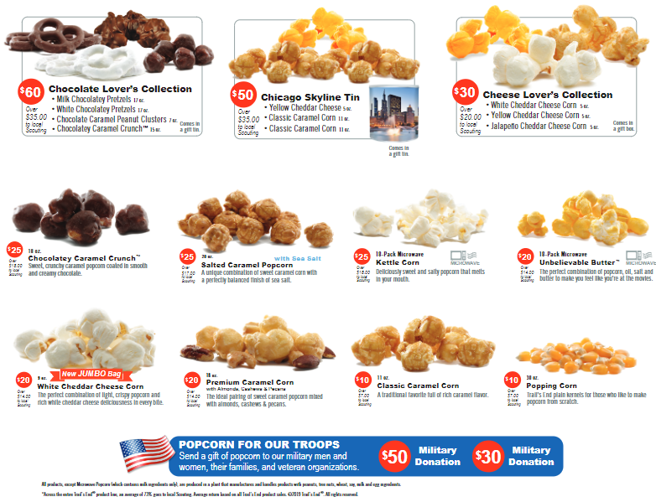
PRODUCTS
Notes:
Insert product mix

Slide 30
YOUR UNIT EARNS
Commission Type: | Commission Percentage:
Commission with Prizes | 33%
Commission without Prizes | 36%
Notes:
5 min

Slide 31
KEY DATES
KEY DATES TO REMEMBER
Show-N-Sell Orders Due | 8/23/2019
Show-N-Sell Distribution | 9/7/2019
Show-N-Sell Returns and Payment Due | 10/25/2019
Take Order Due | 10/25/2019
Take Order Distribution | 11/9/2019
Take Order Payment Due to Council | 12/6/2019
Notes:
Update dates

Slide 32
WE ARE TO HELP YOU SUCCEED
COUNCIL CONTACT INFO
Jared White: Staff Advisor
Jared.White@scouting.org
217.531.0214
TRAILS END SUPPORT
Facebook Group
facebook.com/groups/TEPopcornCommunity
Trail’s End App Support
teappsupport@trails-end.com
General Support
support@trails-end.com
Trail’s End Representative
Jake.Kinnamon@trails-end.com
Notes:
Update dates

Slide 33
THANK YOU
Join us on Facebook!
facebook.com/groups/TEPopcornCommunity

